Slide 1
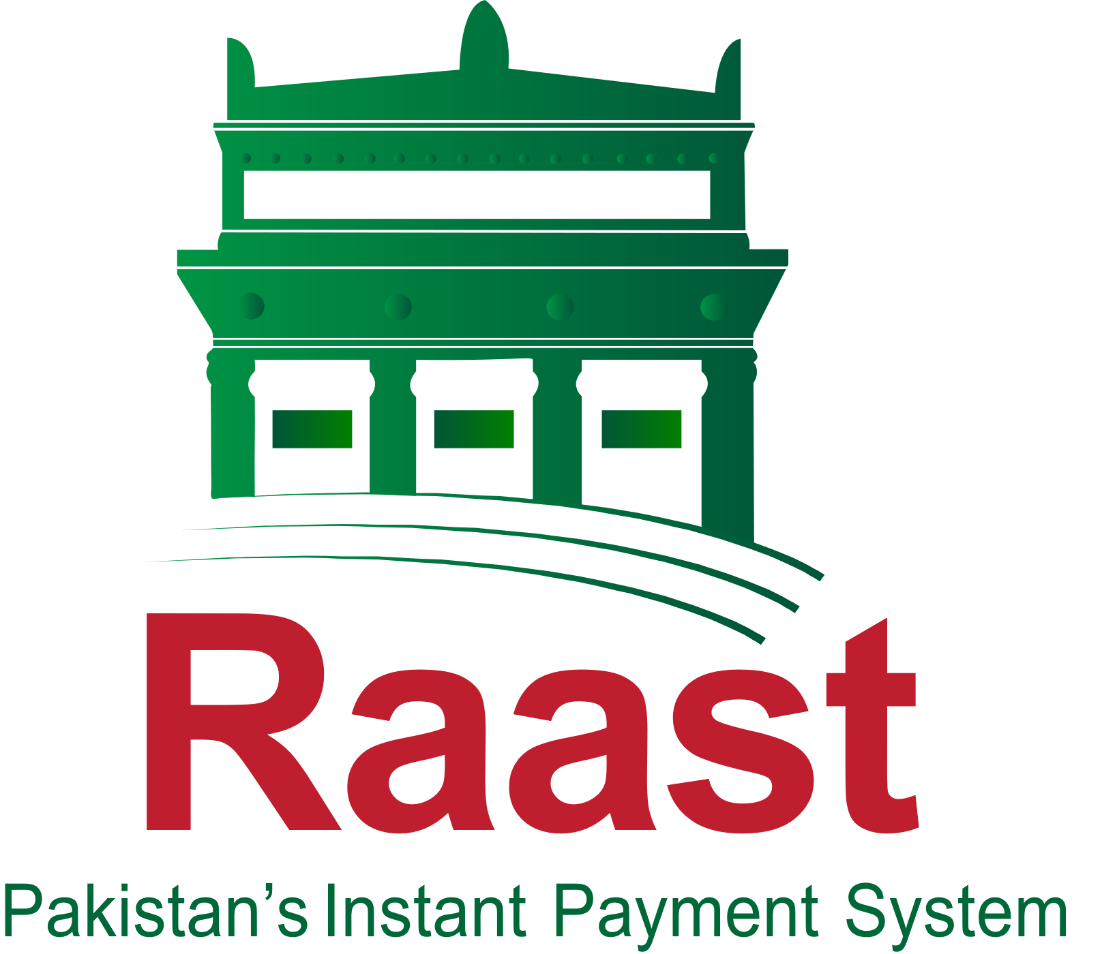

Raast Pakistan’s Instant Payment System
Hina Hameed Deputy Director – Raast Payments Pakistan State Bank of Pakistan

Slide 2
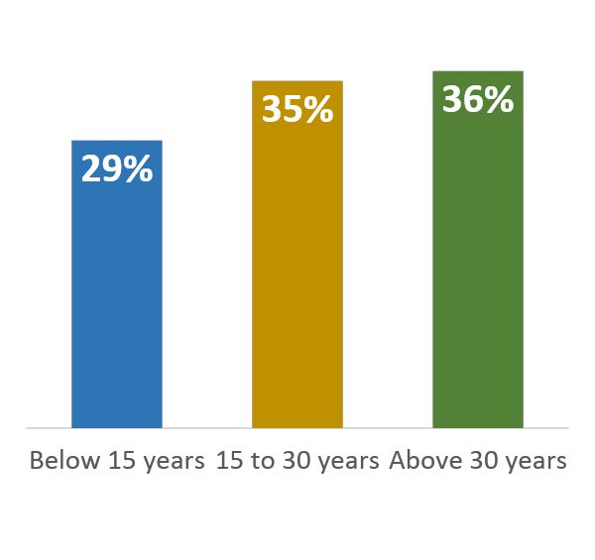
Country Demographics
197 million
Mobile Subscriber
147 million
Broadband Subscriber
143 million
Mobile Broadband Subscriber
Pakistan
Population: 241 million
-------------------------------
Male: 49%
Female: 51 %
Gender Ratio: 104.6
80.3%
Mobile Penetration
Mobile & Internet usage in Pakistan
58.3%
Mobile Broadband Penetration
Age Distribution
More than
9 Million
Overseas Pakistanis
More than
50% Blue Collar Workers
Surface Area: 796,095 Sq. km
Financial Inclusion: ~50%
GDP: ~USD 375 billion
Per Capita Income: ~USD 1,550
Remittance % of GDP ~8%
110 Million Biometrically verified IDs
Issued by NADRA
Note: Population data as per the 2023 digital census

Slide 3
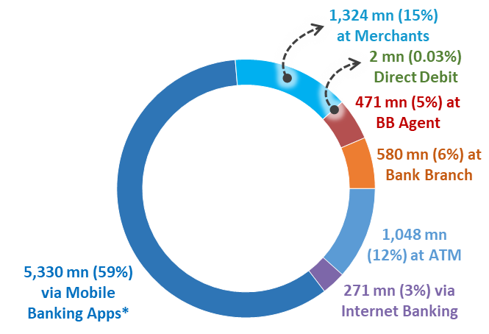
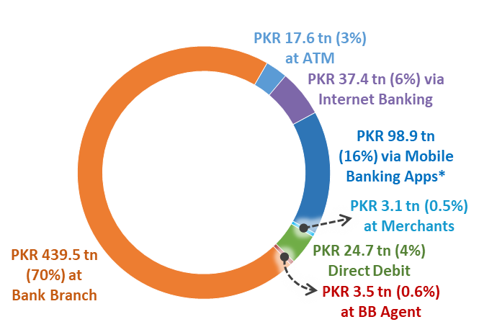
Key Payment Trends in Pakistan
Retail Payments during FY25
Volume
9 billion+
↑43% YoY
Value
PKR 622 Tn
↑13% YoY
88%
Digital Payments
(by Volume)
Transactions at ATMs, Merchant Payments (POS, E-Commerce & QR Merchant), Internet Banking, Mobile App Payments (Banking Apps, Branchless Banking App Wallets, E-money Wallets, Call/IVR), and Direct Debit
Transactions at Branchless Banking Agents, and Bank Branches (Cash Deposits, Cash Withdrawals, Cheque-based Fund Transfers, Pay Order/Demand Draft/ Banker’s Cheque, Bill Payments, and Other Paper-Instruments)
12%
OTC Payments
(by Volume)

Slide 4
Challenges & Considerations
High currency in circulation
Large Informal Economy
Zero cost for merchants and consumers
Cash is
Still the King!
Complex & Cumbersome UI/UX
High cost of transactions
Fear of Documentation / Taxation
Frictions in Digital Payments
Digital Frauds
Lack of interest by banks in digital payment solutions/ support
Expensive and low quality IT related services
IT Infrastructure
Lack of skilled HR
Trust & Others

Slide 5
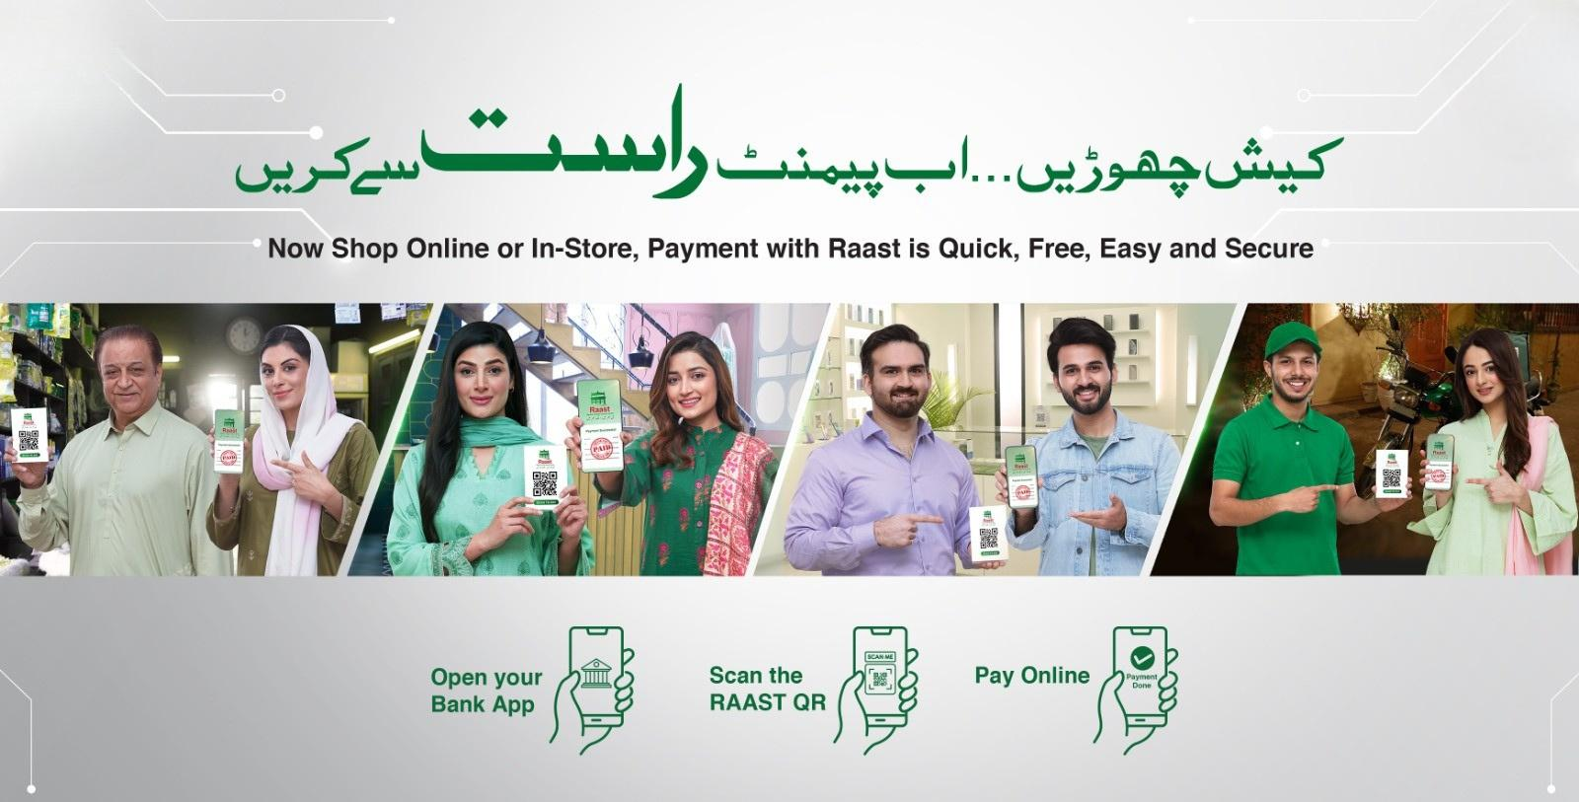
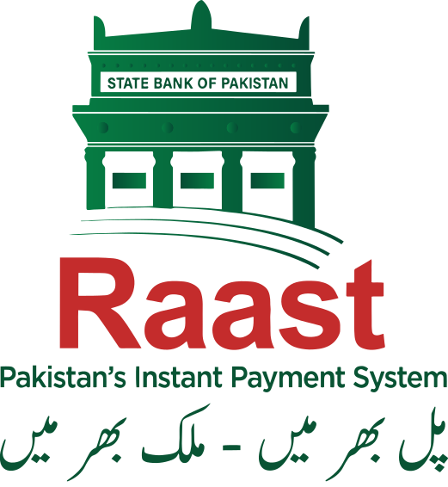
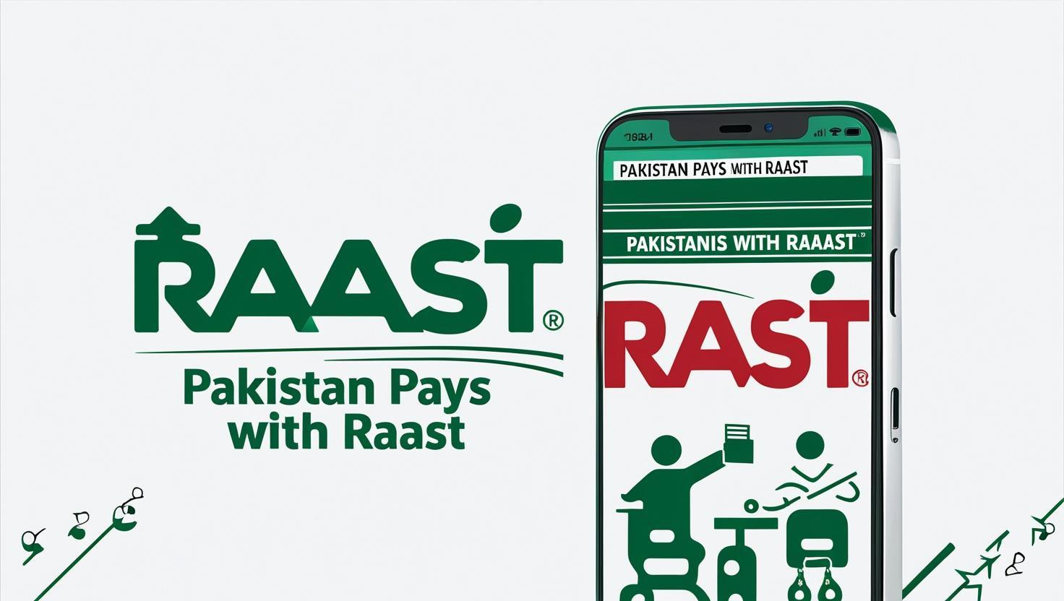


Pakistan's Instant Payments System
Raast is Free!
Login!
Try Now

Slide 6
Raast: Design Principles & Objectives
Open & Interoperable Design: Raast is open to all licensed Digital Financial Service Providers (DFSPs) and built on the ISO 20022 messaging standard, ensuring seamless interoperability across the ecosystem.
Real-Time & Irrevocable Payments: All payments are instant, final, and settled in real time, providing speed, certainty, and reliability for users.
Financial Inclusion: Designed to serve individuals, businesses, and government entities, Raast enables universal access through bulk, person-to-person, and merchant payments.
Fintech & Third-Party Enablement: Raast allows direct participation of fintechs and third-party providers, promoting innovation, competition, and market diversity.
Sustainable Operating Model: Raast operates on a cost-recovery (“not-for-loss”) basis, positioning digital payments as a public utility for national benefit.
Shared Services & Risk Management: Raast ensures resilient cybersecurity and shared infrastructure, while AML/CFT compliance and fraud controls remain with participating DFSPs.

Slide 7



Use-Cases of Raast
Bulk
Payments
Person-to-Person Payments
Person to Merchant Payments
Enables participants and their clients to send batches of payments to Raast customers with full validations
Fast, reliable payments – using mobile numbers and fully interoperable QR Codes
Advance suite of merchant services including QR, Request-to-Pay and Payment Initiation Service

Slide 8
Raast: Products
✔ Already developed 🔄 In pipeline
1
Bulk Payments
✔ Bulk Disbursements (G2X / B2X) via Batch Processing Tool or APIs
🔄 Settlement of POS Transactions
🔄 Social Disbursements
2
P2P
✔ Push to IBAN
✔ Push to RaastID
✔ Push to Customer QR Code (Static/Dynamic)
✔OTC Account Transfers
✔ Push to Merchant QR Code (Static/Dynamic)
✔ Push to Merchant Aliases (Till Code, Virtual Payment Address, MerchantID, Free Text)
✔ Request to Pay: Now (Proximity Payments / online checkouts)
✔ Request to Pay: Later (Bills and invoices)
3
P2M
4
PISP
🔄 Payment Initiation Request (Third Party)
🔄 Customer Consent Framework
5
VAS
✔ Title Fetch
✔ Conversion of Conventional Account to IBAN
✔ Pre-validation of Payment & Payee
✔ End-to-End Payment Credit Confirmation

Slide 9






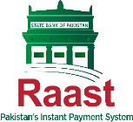



Raast: Markets & Customer Segments
Government
Consumers
01
Push to RaastID, Account
OTC Transfers
Customer QR
Bulk Disbursements (G2X)
Request-to-Pay
Receipts via QR codes
Social Disbursements*
04
Merchants
Investments, Utilities, Insurance
02
Merchant QR (Static/Dynamic)
Merchant Aliases
POS Settlement*
05
Bulk Disbursement
Request to Pay, QR code,
Payment Initiation (PISP)
Corporates
Fintech & e-commerce
03
Bulk Disbursements
Pre-validation of Payee
End-to-End Credit Confirmation
OTC Transfers
Merchant QR
Payment Initiation (PISP)
Interoperable Cash-In/Cash-Out
06

Slide 10

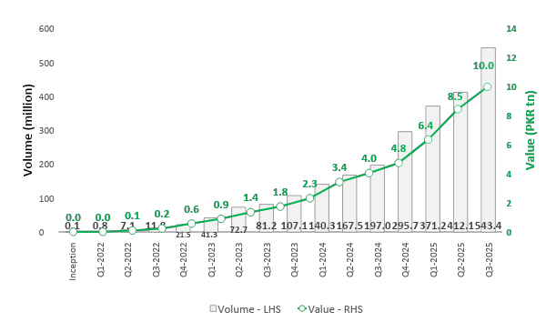



Raast Progress
Raast is now the Largest Digital Payment System in Pakistan
~47 mn
Registered Raast IDs
Since inception
2.5 bn
transactions amounting to
PKR 57 tn
have been processed by Raast.
~1.2 mn
Registered Merchants
~7 mn
Daily avg. no. of trxs
~150 bn
Daily avg. value of trxs
52
Live Raast Participants
25
Currently under onboarding process

Slide 11

Pakistan’s Payment Infrastructure Players
Raast
Retail Payments
Instant Settlement
Alias and QR based
Issuers & Acquirers
Payment System Operators
Banks & MFBs
Electronic Money Issuers
Digital Banks
1Link (IBFT, Bills, PayPak)
NIFT (Cheques, ePayments)
VRG (AMA, Interbank Services)
APPS (Merchant Payments)
Raast Bulk, P2P, P2M
Payment Service Providers
Other Entities
PRISM+
Fintechs
Payment Aggregators
Checkout services
Payment Schemes
Federal and Provincial Governments, Stock Exchange, Central Securities Depository
Institutional Funds Transfer
Central Securities Depository
Advanced Liquidity Management
Real Time Gross Settlement

Slide 12
Adoption Strategy for Raast
Regulatory Support
Pricing
Technology Engagements
User Engagements
Mandate and supervisory oversight of SBP
No charges to use Raast for banks and PSPs
Zero charges for end users for P2P service encouraging widespread usage
Engagement with banks’ teams, technology vendors, students
Engagements with IT Boards and their vendors for Government digitization
Nationwide awareness drives to build trust and familiarity
Marketing Campaigns on Electronic Media
Podcasts and social media campaigns
Raast Merchant QR drive using third parties
Cattle markets, food fairs and other festivals
Participation in exhibitions and conducting promotion activities

Slide 13
Challenges Opportunities
Legacy banking systems, fragmented integrations, and under-resourced IT teams present an opportunity to modernize infrastructure and enhance operational agility.
Capacity Gaps
Conventional Business Models of FIs
Heavy dependence on card schemes and limited adoption of push payment solutions highlight the need for new, home-grown digital business models.
Vendor Bottlenecks in the Industry
A limited pool of vendors and technical expertise underscores the opportunity to develop local capacity and nurture new technology partners.
Resistance to the Pricing Model
Industry pushback on Raast’s cost-recovery model can be transformed into collaboration by demonstrating value, efficiency, and scale benefits.
The absence of structured schemes for discounts, rebates, or cashbacks opens room to design sustainable incentive frameworks that drive adoption and network effects.
Incentive Mechanisms
Expanding Raast’s reach to regional and global payment systems presents a strategic opportunity for faster, cheaper, and more inclusive remittances.
Cross-Border Connectivity
Offline Payments Enablement
Bridging connectivity gaps through QR-based, USSD, or tokenized offline solutions can extend digital payments to remote and underserved populations

Slide 14
Way Forward: Transition Towards Cashless Economy
Prime Minister of Pakistan has taken Cashless Economy Initiative to accelerate adoption of digital payments & achieving a Cashless Pakistan.
Focus areas under this initiative:
Digital Payments Innovation & Adoption: Provision of universal access to digital payments services by increasing the users, touchpoints and transactions of Digital Banking.
Digital Public Infrastructure: Smooth availability of Internet, Operationalization of ‘Digital Nation Pakistan’ and Digitization of citizen services.
Digitize all Government Payments: Convert all G2P & P2G Payments.
Key pillar of this initiative is Raast

Slide 15
Way Forward
Focus on under-served business areas like ecommerce, government-citizen services and corporate on boarding;
Creating Incentives by creation of an Adoption Fund: Establish and manage a dedicated fund for providing discounts, rebates, and cashbacks to accelerate customer and merchant adoption.
Strengthen agreements and SLAs with Vendors
Create liability management rules Create comprehensive liability rules to manage potential risks and liabilities arising from Raast operations.
Establish Technology partnership programmes with vendors and innovation hubs/incubation centres for ensuring quality of integrations and technical compliance

Slide 16
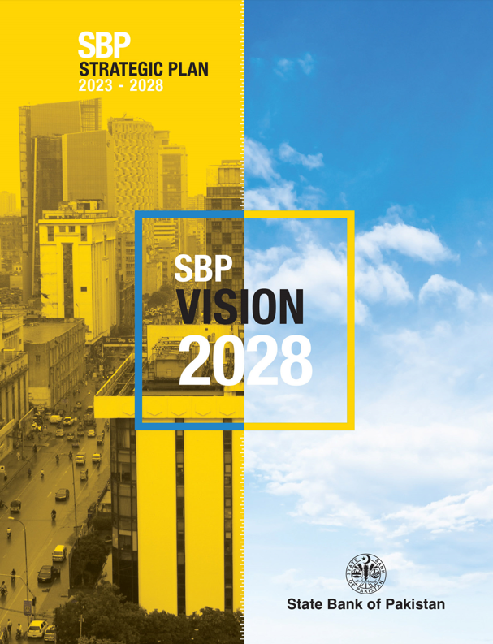
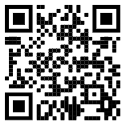
Thanks!

